Slide 1
NAME : SHANTHINI.R REGISTER NO : 312200885 DEPARTMENT : B.COM General 3rd Year COLLEGE : Pachaiyappa’s College For Women

Slide 2
DATA MODELING

Slide 3
Introduction
Process of creating a data model for an information system by applying formal data modeling techniques.
Process used to define and analyze data requirements needed to support the business processes.
Therefore, the process of data modeling involves professional data modelers working closely with business stakeholders, as well as potential users of the information system.

Slide 4
What is Data Model
Data Model is a collection of conceptual tools for describing data, data relationships, data semantics and consistency constraint.
A data model is a conceptual representation of data structures required for data base and is very powerful in expressing and communicating the business requirements
A data model visually represents the nature of data, business rules governing the data, and how it will be organized in the database

Slide 5
A data model provides a way to describe the design of a database at the physical, logical and view levels.
There are three different types of data models produced while progressing from requirements to the actual database to be used for the information system

Slide 6
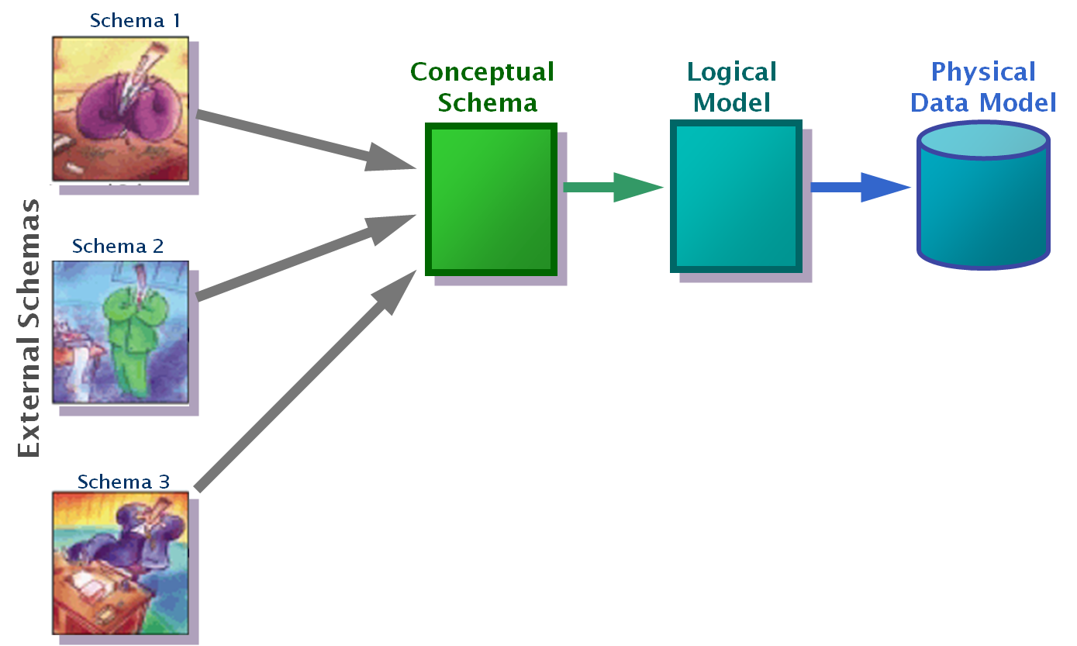
Different Data Models
Conceptual: describes WHAT the system contains
Logical: describes HOW the system will be implemented, regardless of the DBMS
Physical: describes HOW the system will be implemented using a specific DBMS

Slide 7
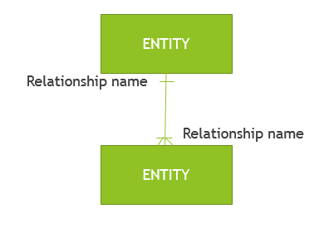
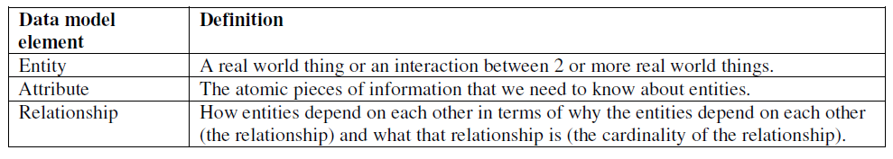
A data model consists of entities related to each other on a diagram:

Slide 8
Example:
Given that …
“Customer” is an entity.
“Product” is an entity.
For a “Customer” we need to know their “customer number” attribute and “name” attribute.
For a “Product” we need to know the “product name” attribute and “price” attribute.
“Sale” is an entity that is used to record the interaction of “Customer” and “Product”.

Slide 9
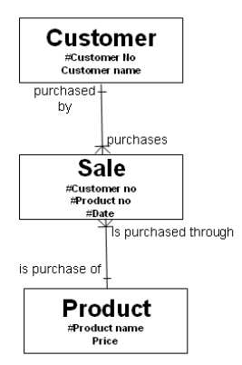
Here is the diagram that encapsulates these rules:

Slide 10
Notes
By convention, entities are named in the singular.
The attributes of “Customer” are “Customer No” (which is the unique identifier or primary key of the “Customer” entity and is shown by the # symbol) and “Customer Name”.
“Sale” has a composite primary key made up of the primary key of “Customer”, the primary key of “Product” and the date of the sale.
Think of entities as tables, think of attributes as columns on the table and think of instances as rows on that table:

Slide 11
Types of Data Models
Entity-Relationship (E-R) Models
UML (unified modeling language)

Slide 12
Entity-Relationship Model
Entity Relationship Diagrams (ERD) as this is the most widely used
ERDs have an advantage in that they are capable of being normalized
Represent entities as rectangles
List attributes within the rectangle
Entity
Primary key
Attributes

Slide 13
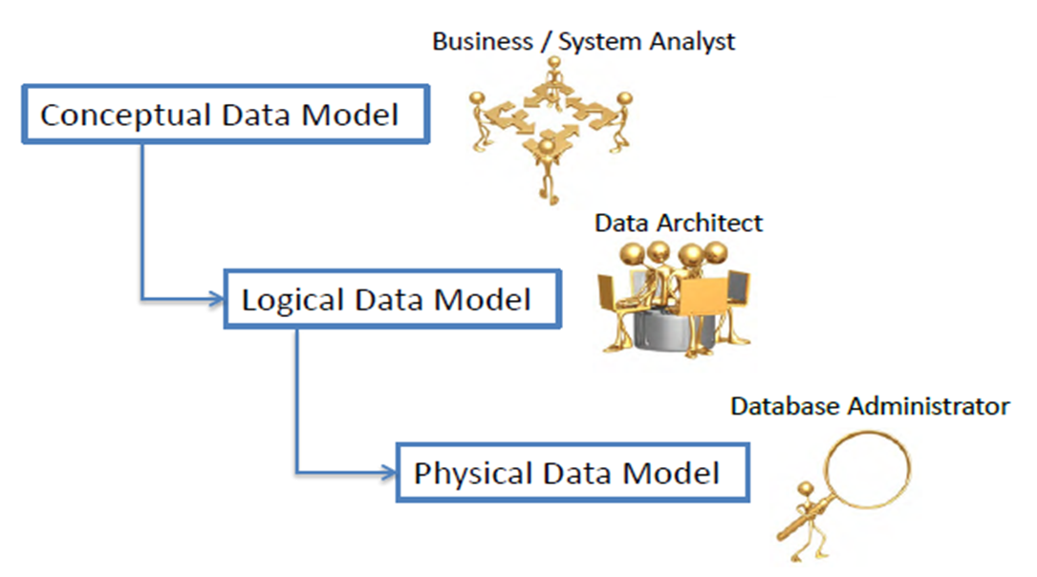
Why and When
The purpose of a data model is to describe the concepts relevant to a domain, the relationships between those concepts, and information associated with them

Slide 14
Significance of Model data
Used to model data in a standard, consistent, predictable manner in order to manage it as a resource.
To have a clear picture of the base data that your business needs
To identify missing and redundant base data

Slide 15
Concluding
To Establish a baseline for communication across functional boundaries within your organization
Provides a basis for defining business rules
Makes it cheaper, easier, and faster to upgrade your IT solutions

Slide 16


